Slide 1
Final Presentation
JIMMY LAUCHOY
DM-UY 2193
PROFESSOR ADEE

Slide 2
My final project started out as a continuation of my midterm, but I ended up starting completely from scratch and built my site using a combination of fancybox, GSAP, and jQuery. It no longer showcases only my photo/video work but also web development skills
FINAL WEBSITE

Slide 3
Midterm Homepage

Slide 4
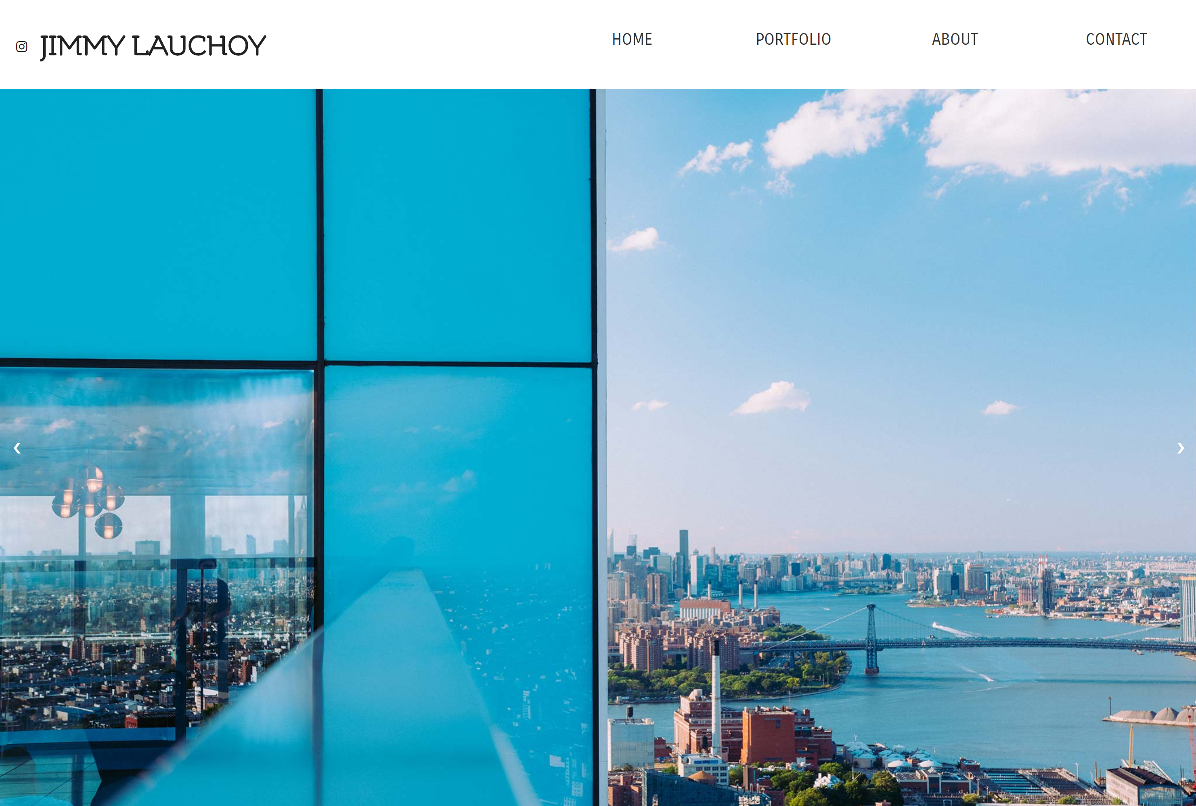
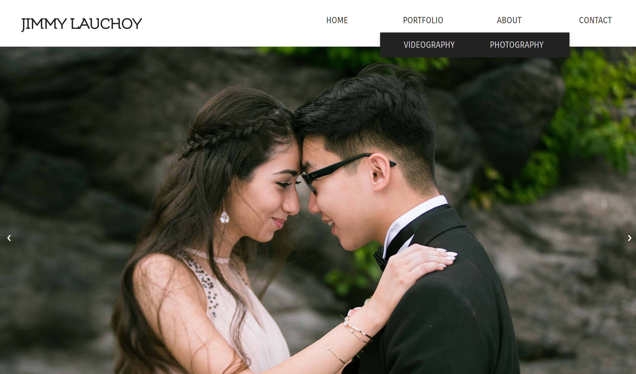
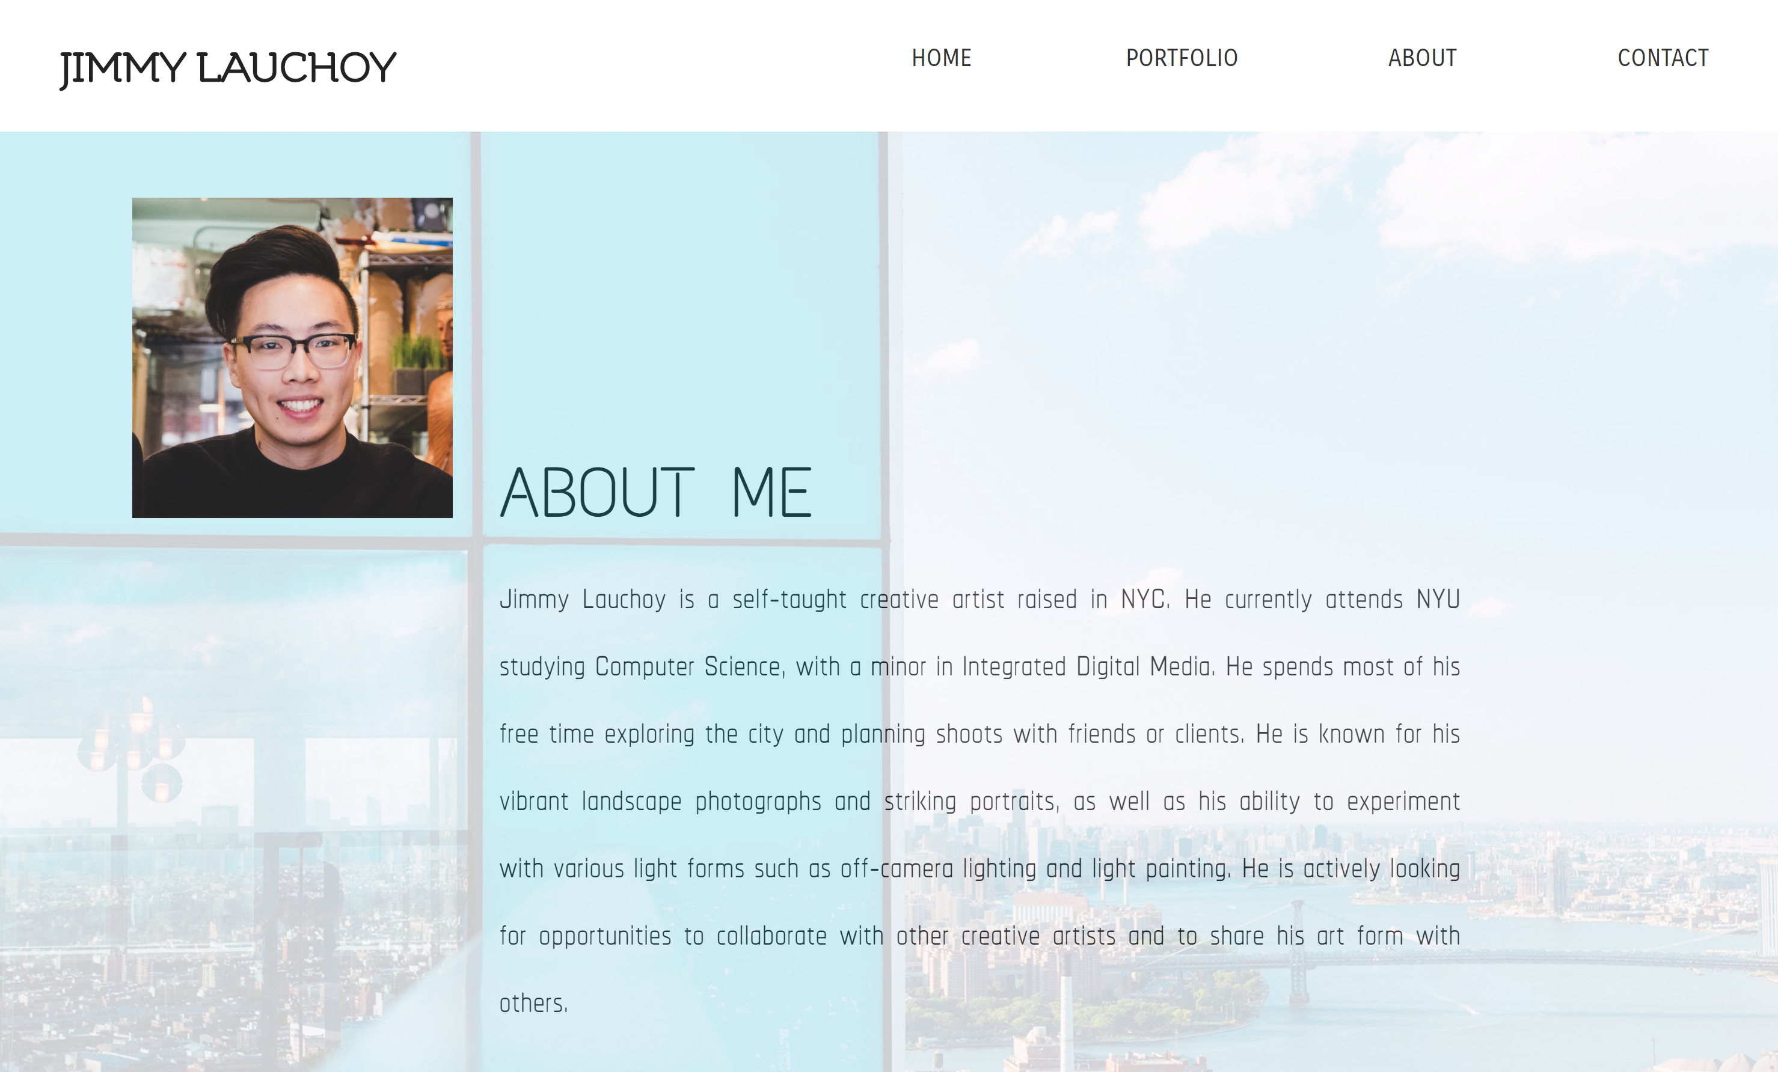
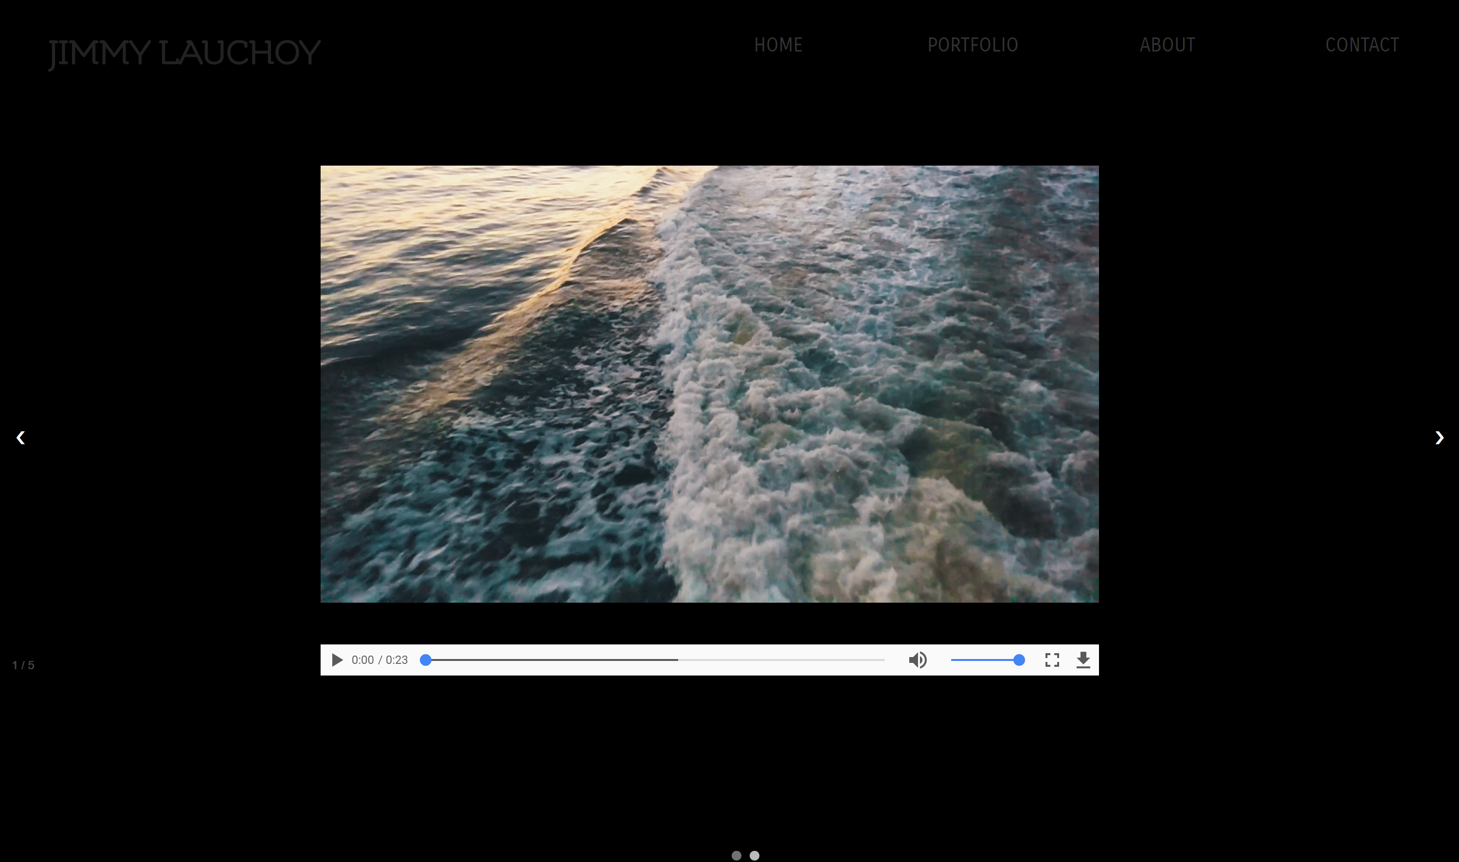
HOME
PHOTO
http://sites.bxmc.poly.edu/~jimmylauchoy/WD/
ABOUT
VIDEO

Slide 5
New Site

Slide 6

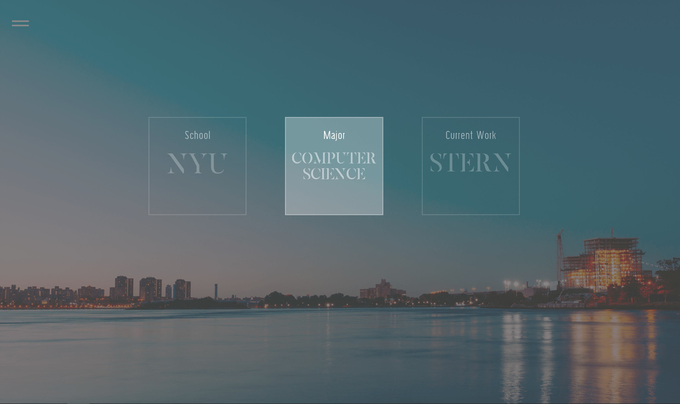
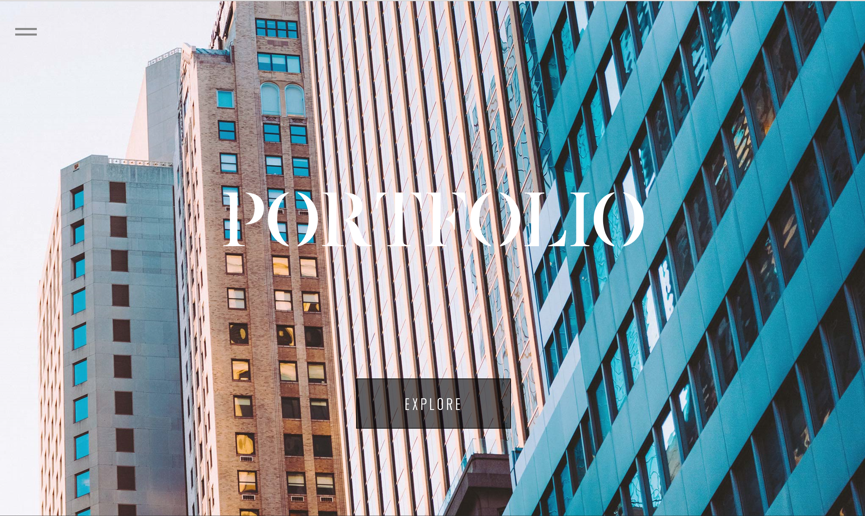
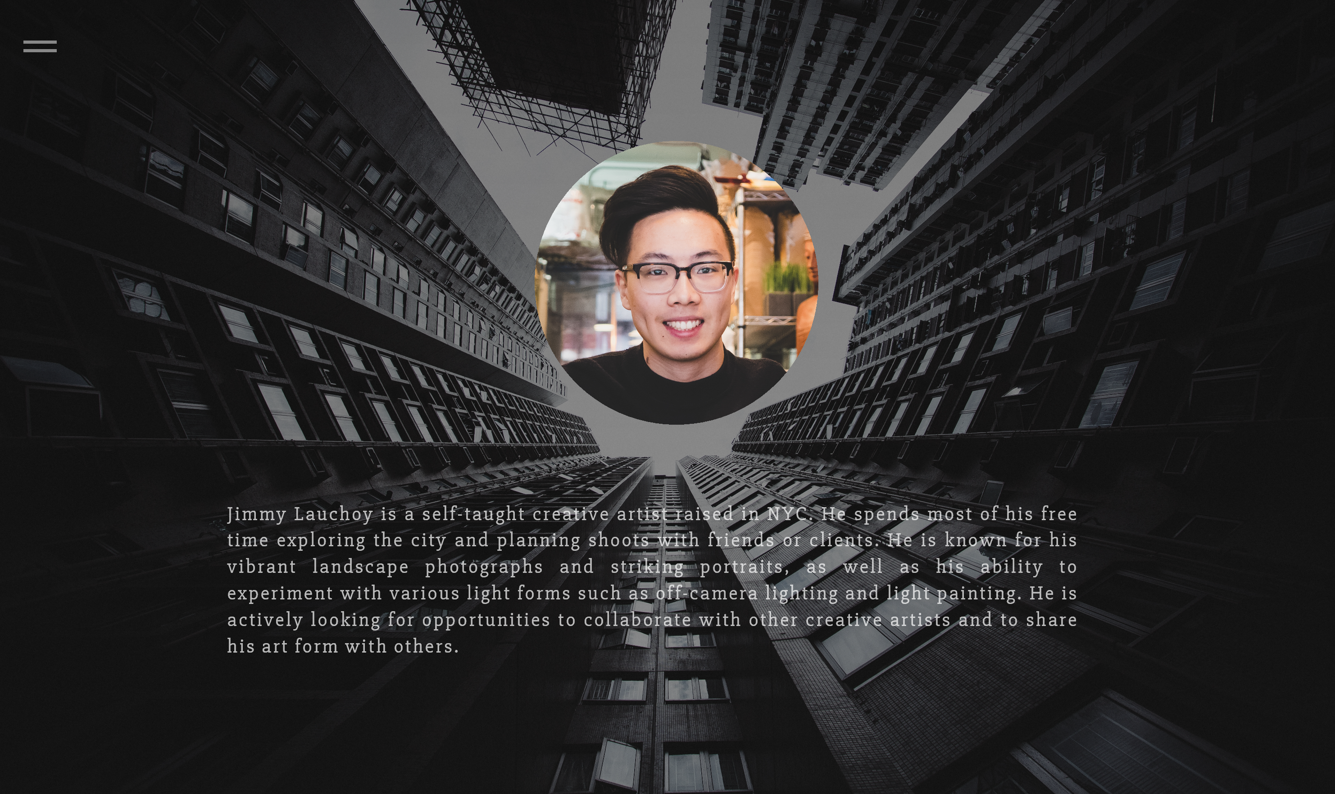
(Scroll down)

Slide 7


New Nav Bar
sandwich style vs hamburger

Slide 8
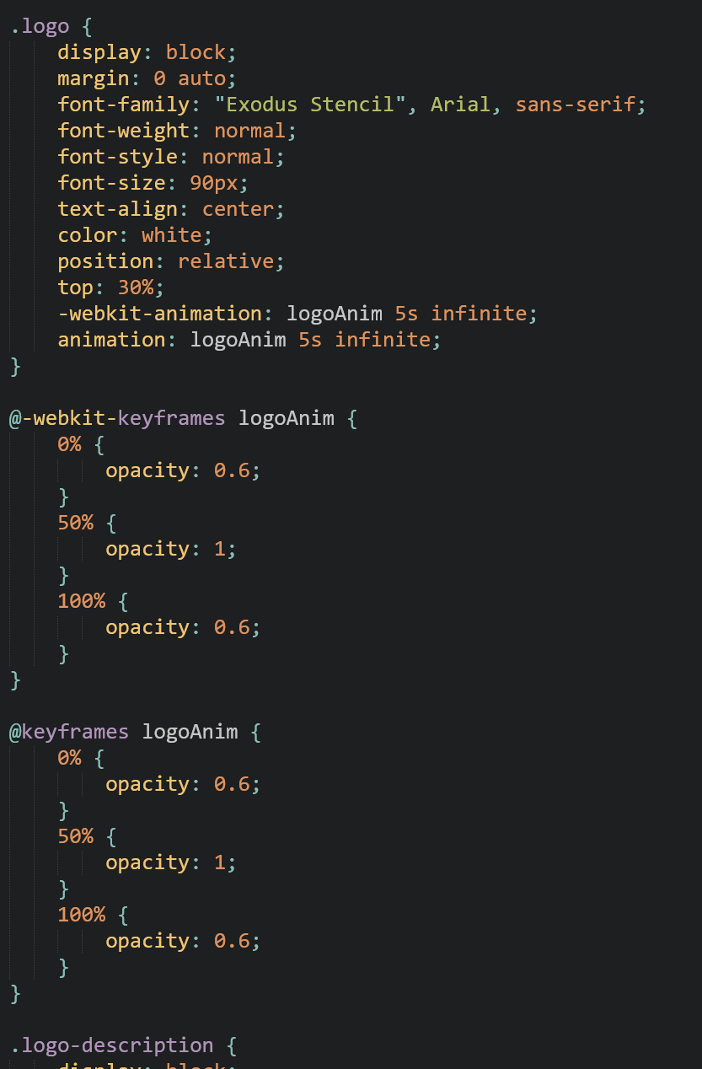
New Logo
breathing effect

Slide 9
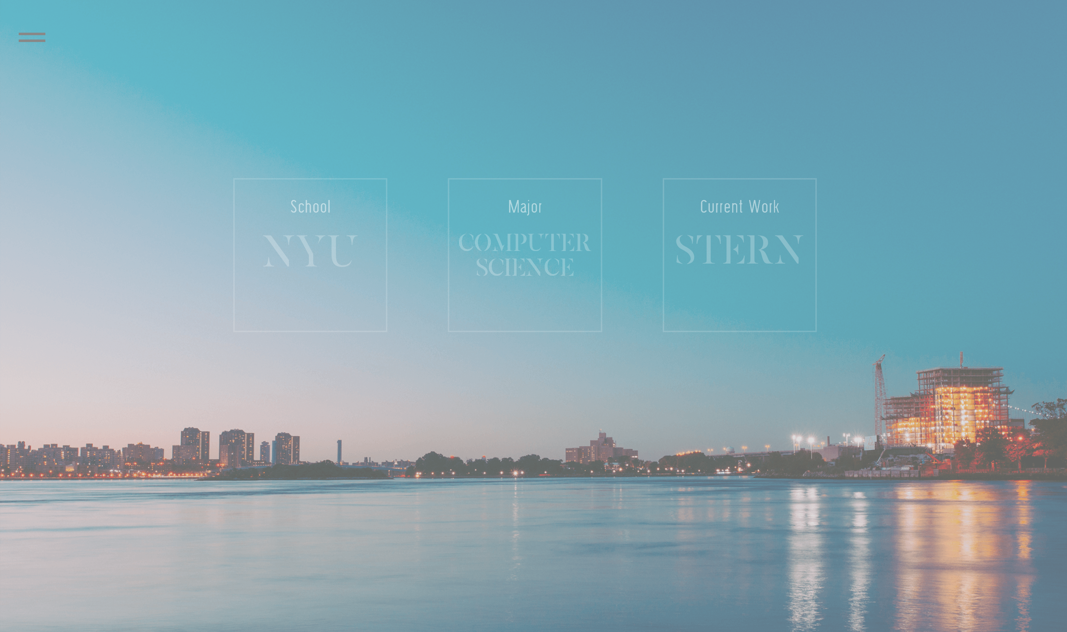
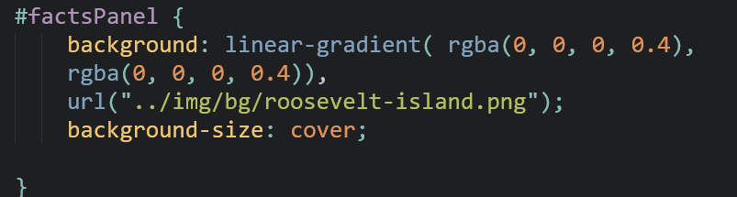
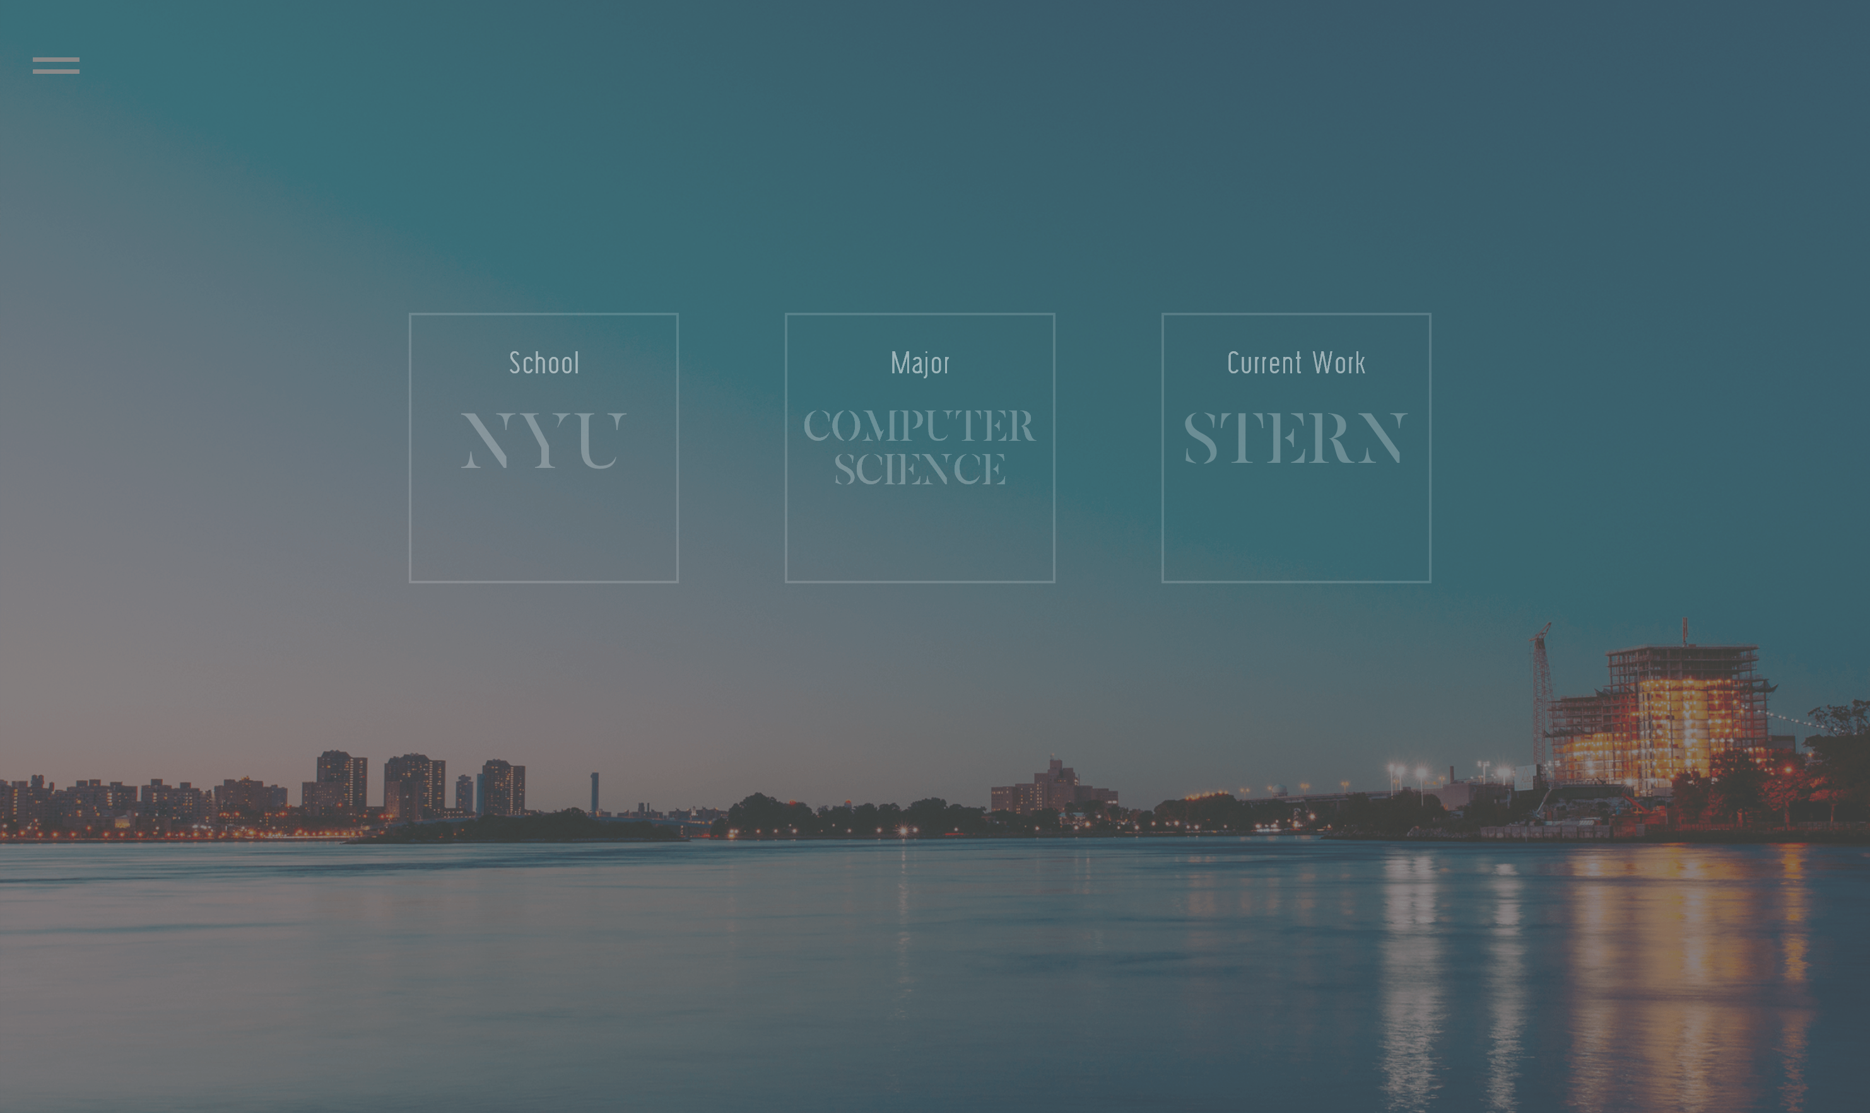
Darkening backgrounds
no need to Photoshop!

Slide 10
Completely new interface
Intro screen features logo and a short description
viewer can scroll through the page
Nav bar is completely newly designed
Can be accessed anywhere on the page on left hand side
Clicking on a section scrolls to that section panel
Quick facts
Fades in background color when hovered,
clicking on a fact activates drop down with more description
About page
simple, let the page do the talking
Contact links added to the bottom of nav bar
New Content
(Front End)

Slide 11
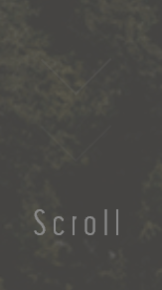

New Content (Front End)
Animated “scroll down” arrow

Slide 12


New Content (Front End)
New Content (Front End)
Gallery Panel
cycles through photo backgrounds

Slide 13
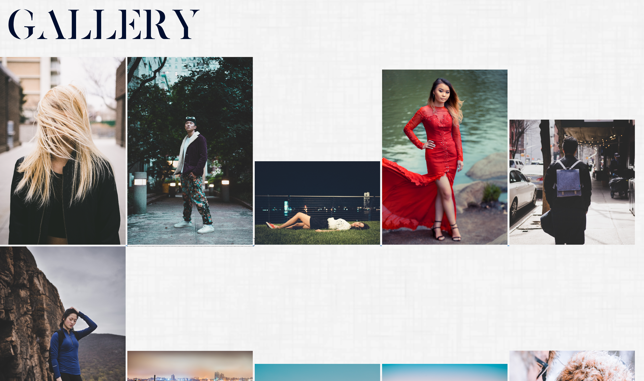
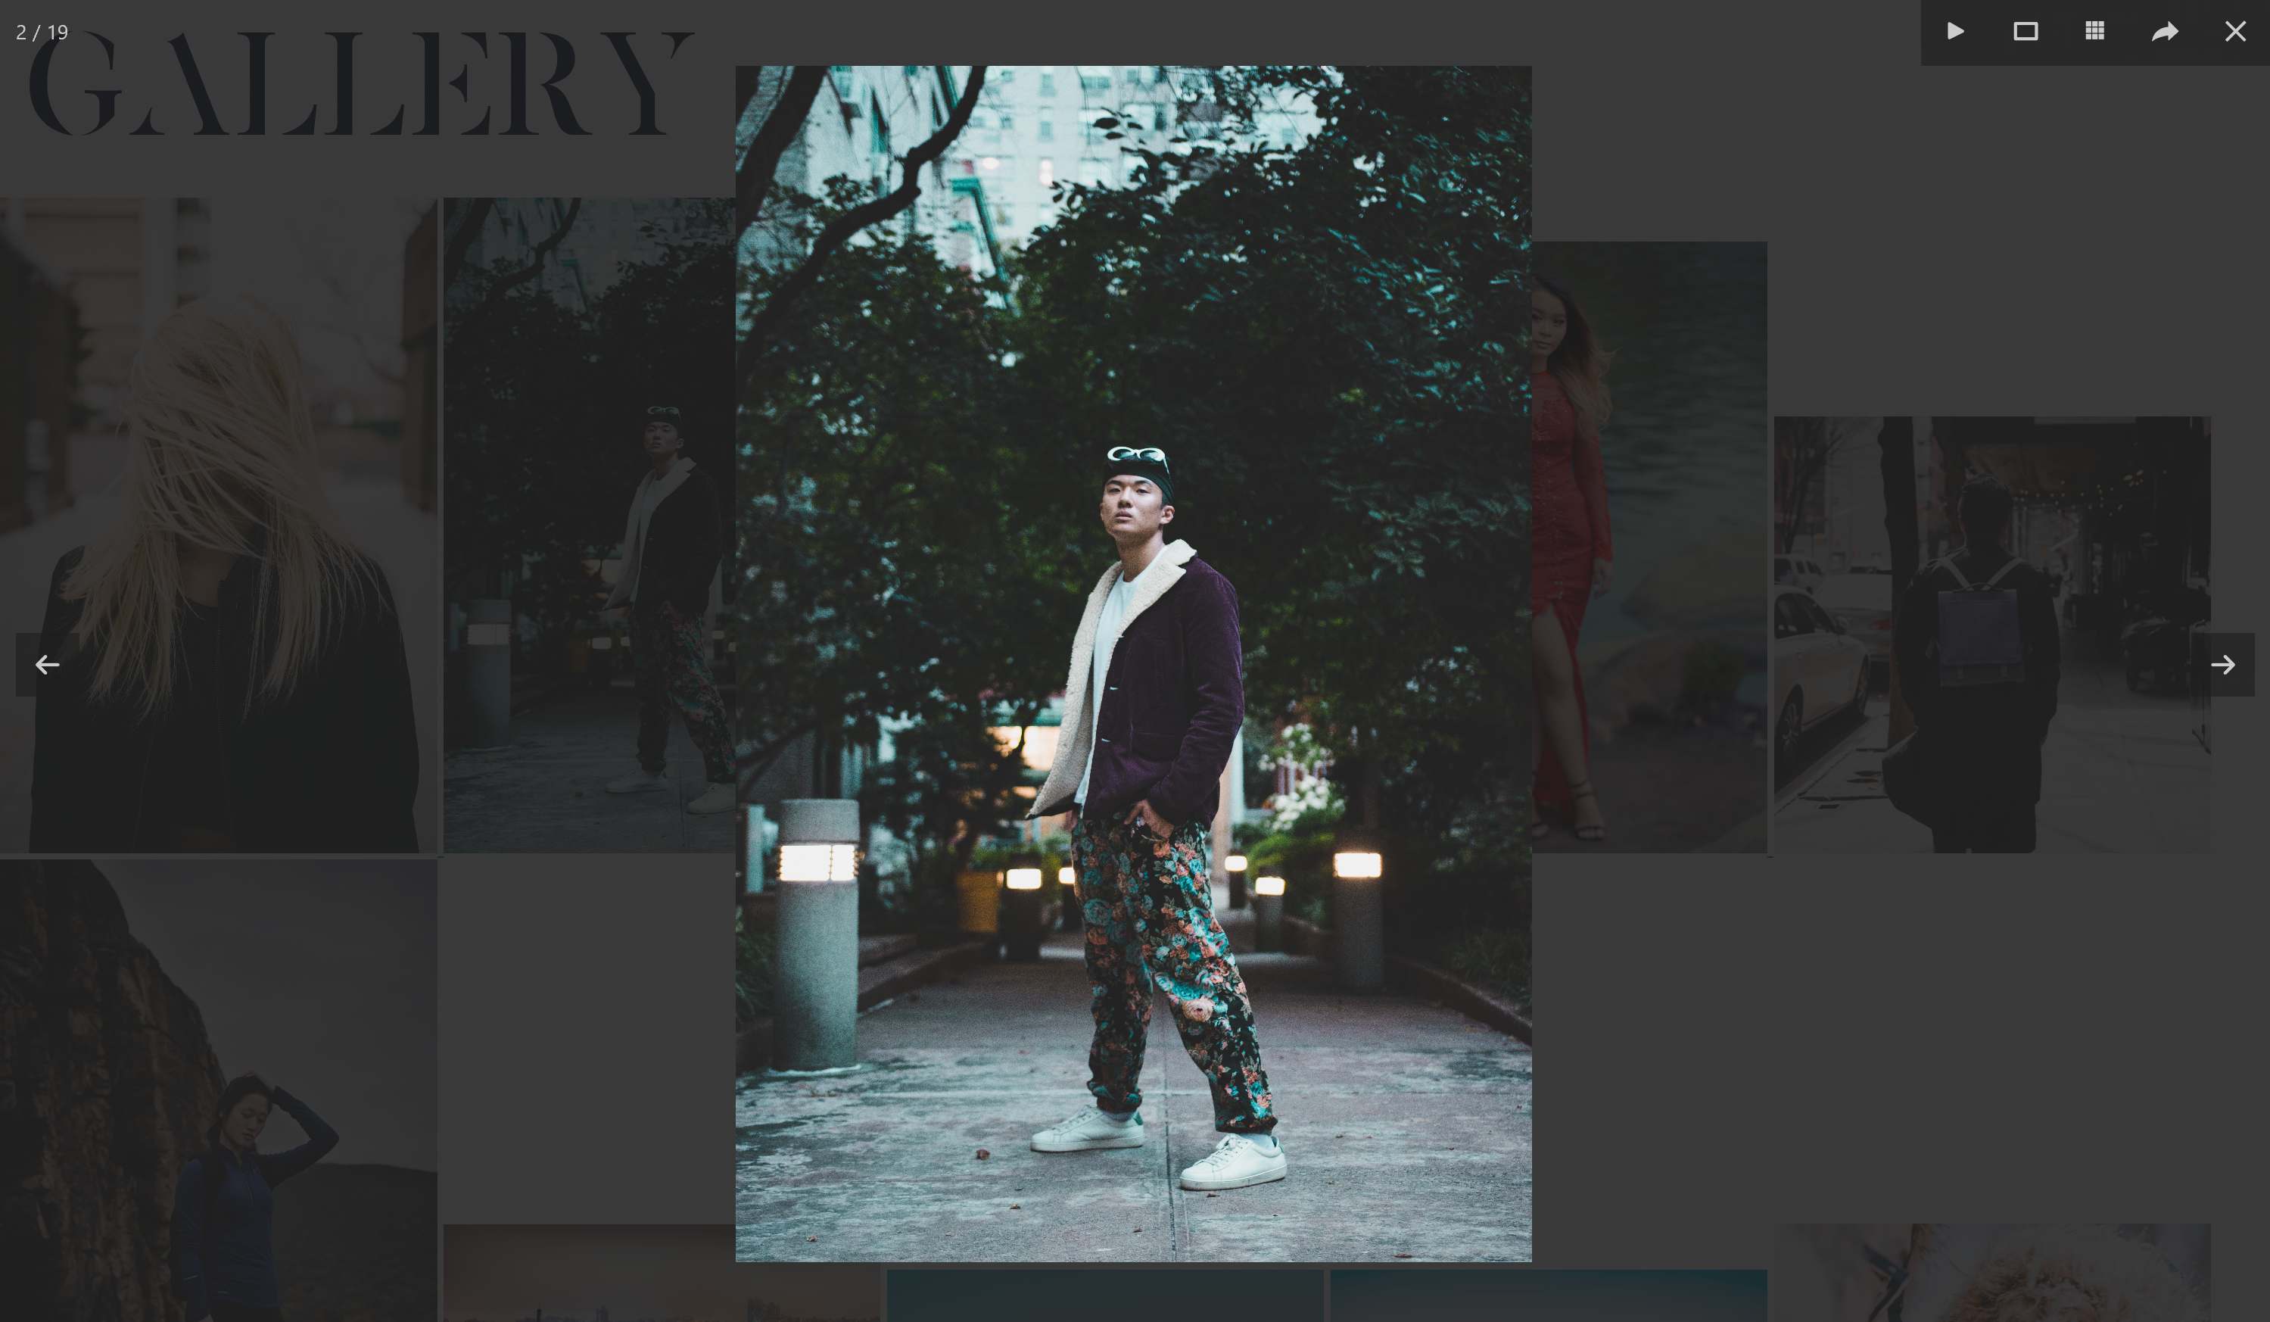
Gallery Page
needs to be organized by category (mixitup)
PHP to automatically load image from folders

Slide 14
New Content (Back End)
Improve load time of photos/videos
Better transitions
Smooth scrolling (jQuery)
Mobile scaling

Slide 15
HOSTING
Host the webpage on my personal page: jimmylauchoy.me

